Slide 1
Philosophical questioning major trends in renaissance philosophy
Dr. Stephanie Spoto
8/22/2019
Monterey Peninsula College
GENT 8/408: Late Renaissance and Reformation (1520-1600)

Slide 2

Philosophical questions
What happens when we die?
Why are we here?
How does one live the good life?
What is the good society?
Who are we? What does it mean to be human?
Where did we come from?
What is beauty? Truth? God?

Slide 3
Humanism
Study of classical antiquity
A shift in focus from exclusive study of religion towards the study of humankind
Returning interest in the pagan classics stimulated three major shifts in European philosophy:
  the philosophy of secularism
  the appreciation of worldly pleasures
  Assertion of personal independence and individual expression
Crossroads between medieval supernaturalism and modern skeptical and scientific paradigms

Slide 4
Sixteenth century natural philosophy
Century before the Scientific Revolution of the seventeenth century
Renaissance Natural Philosophy: defies simple definition (Don’t want to over simplify)
  Reducing it to continuation of medieval science:
    Conflation of 15th-16th century Natural Philosophy into mere continuation of medieval philosophy
    Interpreted as conservatism (either “medieval” or “classical”)
  “Looking Forward”/ False Teleology:
    pressing it into false teleology which is completed in the Scientific Revolution
    Mere “foundation” or “precursor” to modern science
    Sometimes ignores importance of “sciences” like astrology, alchemy, and magic.

Slide 5
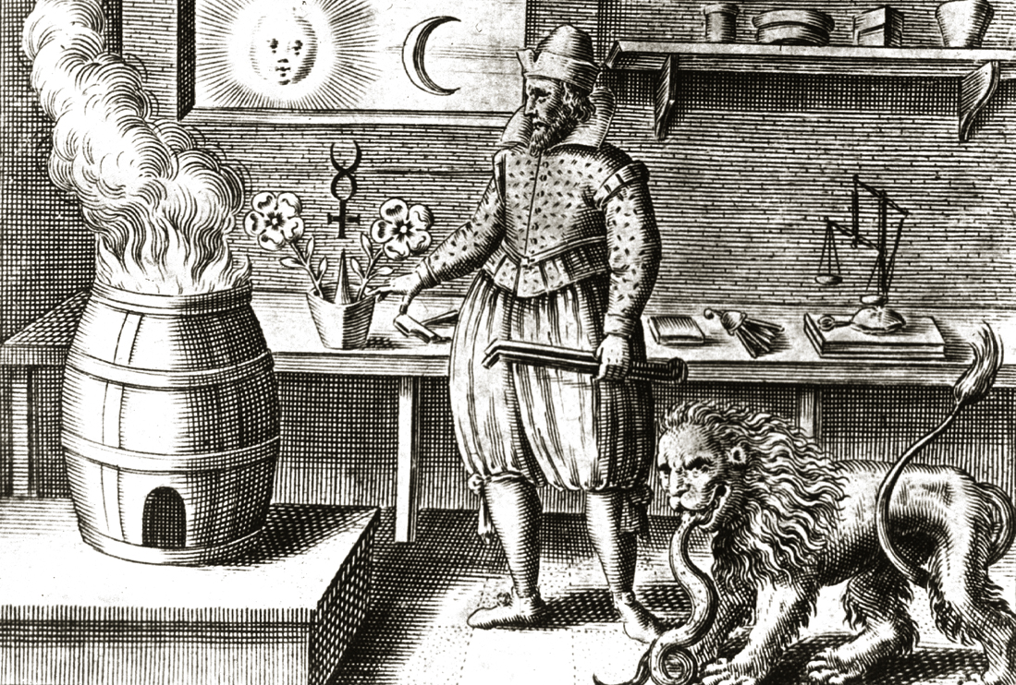
Illustration of an alchemy workshop in Johann Mylius, Opus Medico-Chymicum, 1618

Slide 6
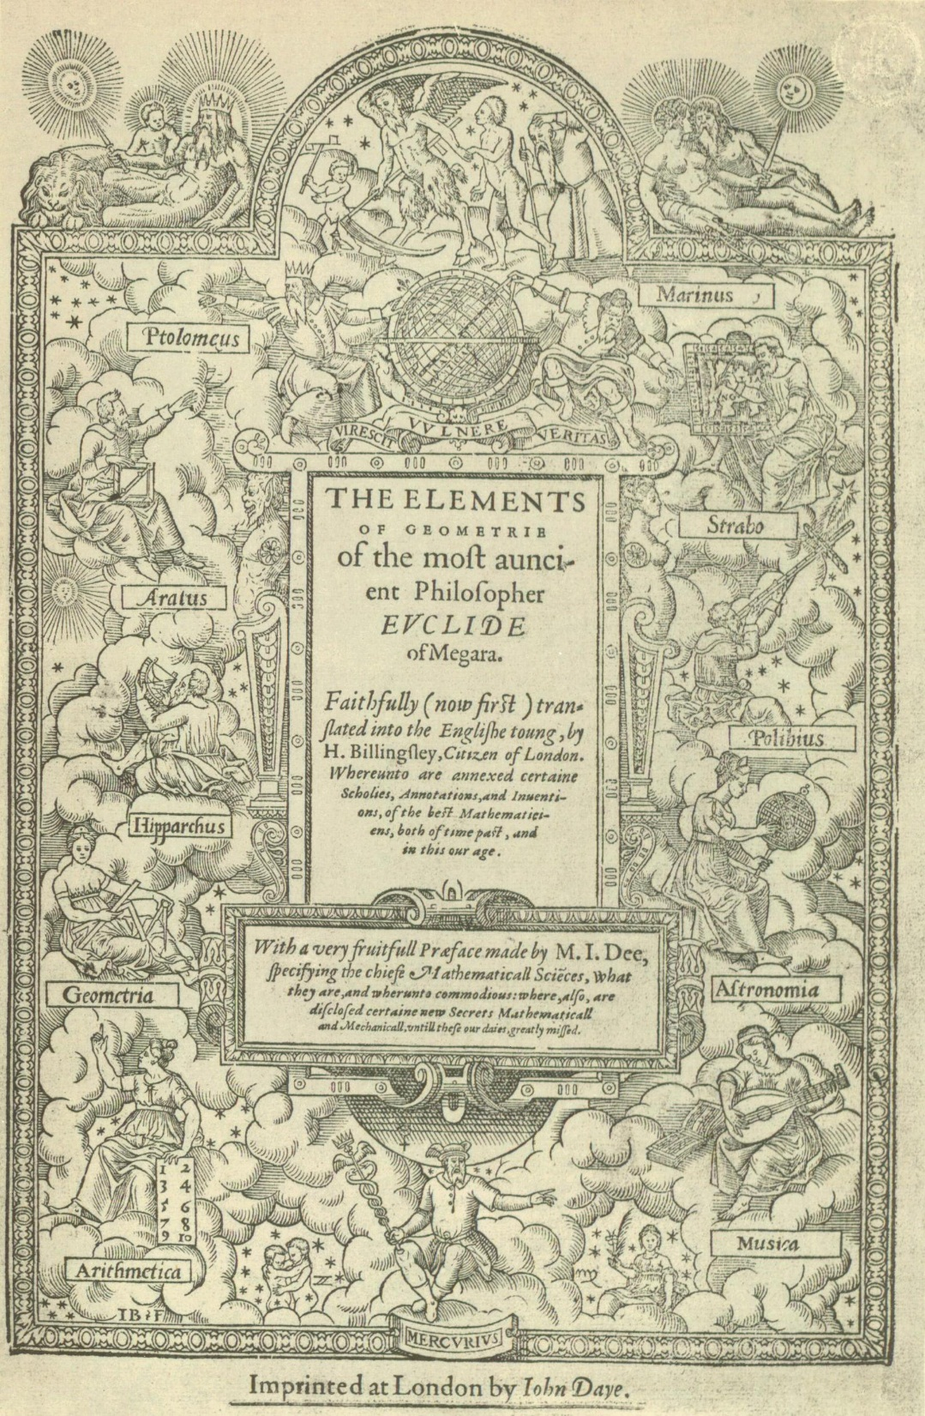
John Dee
1527-1608/9
Court astrologer to Elizabeth I
Mathematician, occultist, astronomer, alchemist
Straddled science and magic (but would not have felt a distinction between the two)
"A marveilous newtrality have these things mathematicall, and also a strange participation between things supernaturall and things naturall."

Slide 7
John Dee’s Angelic Conversations
In the late sixteenth-century, John Dee and Edward Kelly began their “angelic experiments”: attempts to communicate with angels.
Believed there was a connection between the material world and the suprasensory world.
Would attempt to discover the location of the Spanish Armada for Elizabeth.

Slide 8
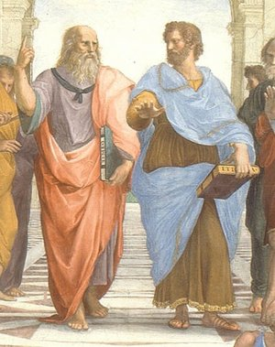
The beginning of separation from Natural Sciences and Philosophy
Plato’s philosophy didn’t wane in influence
Brought together as part of the fifteenth century Neo-Platonic project.
Creation of clear distinction between Aristotle and Plato.
Plato: thinker of metaphysical realities, theology
Aristotle: perceived as thinker of metaphysical realities; investigator of the physical world.

Slide 9
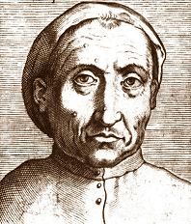
Pietro Pomponazzi (1462–1525)
Removing the Theological from Aristotle
Pietro Pomponazzi read Aristotle for secular/scientific reasons → removal of focus on theological.
Developed his philosophies entirely from the field of natural philosophy
Treatise on the Immortality of the Soul, 1516: If some part of the intellect is to survive the body’s death, then there must be evidence in the action or activity of the intellect → must function independently of the body.
  No Independence found
  Intellect always mediated by sense impression
  Therefore, according to Aristotelian principles, the soul dies with the body

Slide 10
Jacopo Zabarella (1533-1589)
Aristotle and the Scientific Method
Jacopo Zabarella → wrote prolifically on the subject of the scientific method and the nature of logic
Aristotle’s authority should be subject to rational criticism and should be independent of theology.
Goal: Discovery of the authentic Aristotelian ideas of science and the scientific method → unarguable demonstration of nature and principles of the natural world.
Regressus: method developed that he believed was the best method for reaching knowledge in the theoretical sciences.
  Combination of the deductive methods of composition and the inductive methods of resolution
Opera logica (1578): mainly devoted to the theory of demonstration
De rebus naturalibus (1590): major work in natural philosophy→ helped a renewal of natural philosophy, methodology, and theory of knowledge.

Slide 11
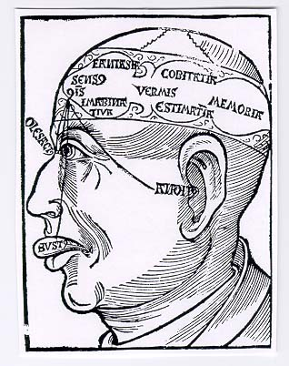
The Study of the Human
16th century: mixture of scholastic and humanist traditions.
Development of more human centered disciplines.
Creation of new vocabulary:
  “Psychology”: Study of the human soul.
    Coined by Marko Marulić, d. 1524 – Croatian poet and philosopher
  “Anthropology”: study of relationship between body and soul – both comprising human nature.
Gregor Reisch, Margarita philosophica, 1504

Slide 12
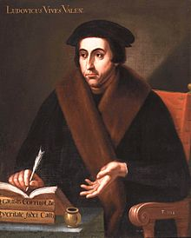
Juan Luis Vives (1493-1540)
The Father of Modern Psychology
Many philosophers in the sixteenth century interested in Aristotle’s idea of the soul as operating on two axes:
  Emotions and desires (sensitive-intellective)
  The Will (cognitive-appetitive)
However, Juan Luis Vives (Humanist, scholar, philosopher), explored an alternative to Aristotle’s model of psychology
  Rejected metaphysical approaches to the soul
  Emphasizes understanding the soul through its functionality
  We do not have the intellectual ability to completely grasp what the soul is.

Slide 13
Two competing Scottish views on Witchcraft
The Discoverie of Witchcraft, 1587
Reginald Scot, Edinburgh
Daemonologie, 1597
James VI of Scotland
Skeptical of the reality of witchcraft, sorcery, magic
Attempted to prove that magicians were charlatans
The persecution of witches was un-Christian
Witches, sorcery, magic (learned or unlearned) was Satanic
Threatens the nation-state, anarchic
No place for sorcery in learned institutions

Slide 14
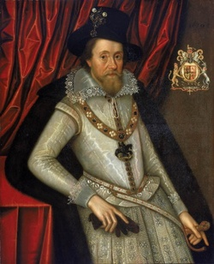
John Dee and the Ascension of James VI of Scotland, James I of England
Death of Elizabeth, John Dee’s patron
Ascension of James VI of Scotland, 1603
New and more hard-lined approach to the uses of magic in universities and in courts
Effect:
  Magic and science no longer continuous in the courts → magic no longer used politically
  Much less commonplace in the universities (this is also to do with other trends)

